Slide 1
DATA ENCRYPTION STANDARD (DES)

Slide 2
Outline
History
Encryption
Key Generation
Decryption
Attacks On DES
DES Cracker
Improved Key Size for 2DES,3DES

Slide 3
History
In 1971, IBM developed an algorithm, named LUCIFER which operates on a block of 64 bits, using a 128-bit key
Walter Tuchman, an IBM researcher, refined LUCIFER and reduced the key size to 56-bit, to fit on a chip.

Slide 4
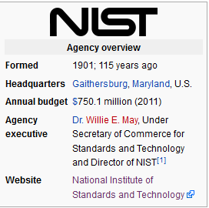
History
In 1977, the results of Tuchman’s project of IBM was adopted as the Data Encryption Standard by NBS (NIST).

Slide 5
Feistel Cipher Structure
Block size: larger block sizes mean greater security
Partition the data block into two halves L and R
Key Size: larger key size means greater security
Number of rounds: multiple rounds offer increasing security
In each round,
  R does not change.
  L goes through an operation that depends on R and a round key derived from the key.
Subkey generation algorithm: greater complexity will lead to greater difficulty of cryptanalysis.
Fast software encryption/decryption: the speed of execution of the algorithm becomes a concern

Slide 6
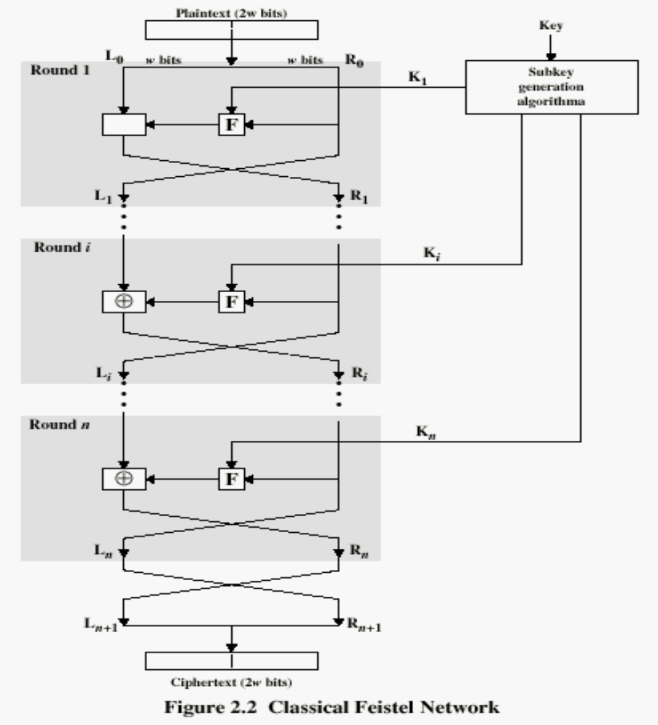

Slide 7
DES: The Data Encryption Standard
Most widely used block cipher in the world.
Based on the Feistel cipher structure processing.
Ruled for more than 3 decades.
Rounds = 16 no
Block = 64 bits
Key = 56 bits
What is specific to DES is the design of the F function and how round keys are derived from the main key.

Slide 8
Design Principles of DES
To achieve high degree of diffusion and confusion invented by Claude Shannon .
Diffusion: making each plaintext bit affect as many cipher text bits as possible.
Confusion: making the relationship between the encryption key and the cipher text as complex as possible.
1

Slide 9

6.1.2 Overview
DES is a block cipher, as shown in Figure
Figure . Encryption and decryption with DES
6.<number>

Slide 10
Encryption
64-bit plain-text (X)
Initial Permutation (IP)
64-bit key (K)
Key _{i}
Round _{(i)}
Key Generation (KeyGen)
32-bit Switch (SW)
Inversion of Initial Permutation (IP⁻¹)
64-bit cipher-text (Y)

Slide 11
Encryption Steps In DES
Plain text:64-bit
Initial Permutation: IP( )
Divide in 32-bit LPT+RPT
Round_{i}: 1≤ i ≤ 16 key
Final Permutation Inverse IP: IP⁻¹( )
Cipher text:64-bit

Slide 12
Initial Permutation IP
IP: the first step of the encryption.
It reorders the input data bits.
The last step of encryption is the inverse of IP.
IP and IP⁻¹ are specified by tables
http://en.wikipedia.org/wiki/DES_supplementary_material

Slide 13
Initial Permutation (IP)
IP
Bit | 0 | 1 | 2 | 3 | 4 | 5 | 6 | 7
1 | 58 | 50 | 42 | 34 | 26 | 18 | 10 | 2
9 | 60 | 52 | 44 | 36 | 28 | 20 | 12 | 4
17 | 62 | 54 | 46 | 38 | 30 | 22 | 14 | 6
25 | 64 | 56 | 48 | 40 | 32 | 24 | 16 | 8
33 | 57 | 49 | 41 | 33 | 25 | 17 | 9 | 1
41 | 59 | 51 | 43 | 35 | 27 | 19 | 11 | 3
49 | 61 | 53 | 45 | 37 | 29 | 21 | 13 | 5
57 | 63 | 55 | 47 | 39 | 31 | 23 | 15 | 7
Note: IP(IP⁻¹) = IP⁻¹(IP) = I

Slide 14
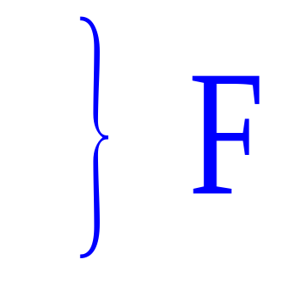
Details of Single Round in DES
Separate plaintext as L₀R₀
  L₀: left half 32 bits of plaintext
  R₀: right half 32 bits of plaintext
  Key Transformation
Expansion/permutation: E( )
Substitution/choice: S-box( )
Permutation: P-Box( )
X-OR & Swap

Slide 15
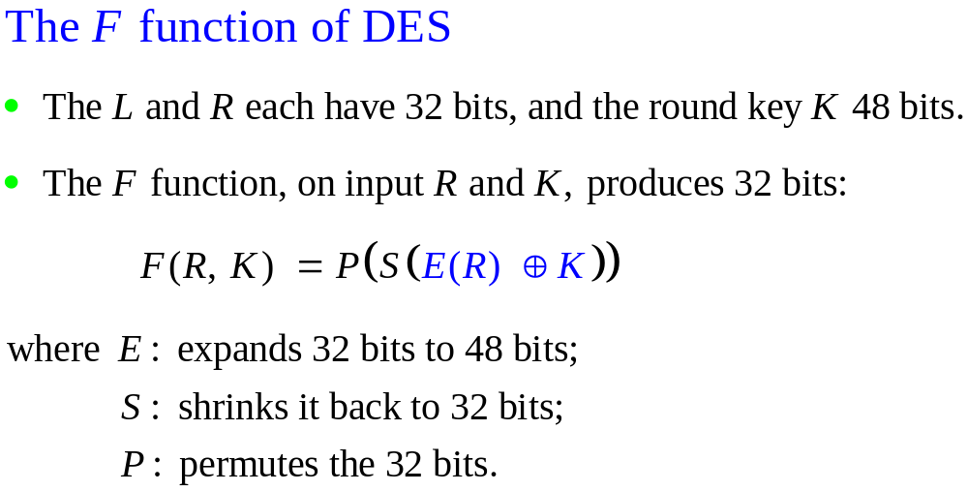

Slide 16
Step 1: Key Generation
Original Key: Key₀
Permuted Choice One: PC_1( )
Permuted Choice Two: PC_2( )
Schedule of Left Shift: SLS( )
It involves permutation & selection
Compression from 56 bit key to 48 bit key
Round = 1,2,9,16 -> PC_1( )
Round = Remaining-> PC_2( )
No of key bit shifted

Slide 17
Round Key/Sub Key Generation
Main key: 64 bits.
56-bits are selected and permuted using Permuted Choice One (PC1); and then divided into two 28-bit halves.
In each round:
  Left-rotate each half separately by either 1 or 2 bits according to a rotation schedule.
  Select 24-bits from each half, and permute the combined 48 bits.
  This forms a round key/sub key.
Notes:
The 56 bit key size comes from security considerations as we know now. It was big enough so that an exhaustive key search was about as hard as the best direct attack (a form of differential cryptanalysis called a T-attack, known by the IBM & NSA researchers), but no bigger. The extra 8 bits were then used as parity (error detecting) bits, which makes sense given the original design use for hardware communications links. However we hit an incompatibility with simple s/w implementations since the top bit in each byte is 0 (since ASCII only uses 7 bits), but the DES key schedule throws away the bottom bit! A good implementation needs to be cleverer!

Slide 18
Key Generation
Input Key
Permuted Choice One (PC-1)
C₀
D₀
▪
▪
▪
▪
▪
▪
C_{i-1}
D_{i-1}
Permuted Choice Two (PC-2)
Key_{i}
Schedule of Left Shifts
C_{i}
D_{i}

Slide 19
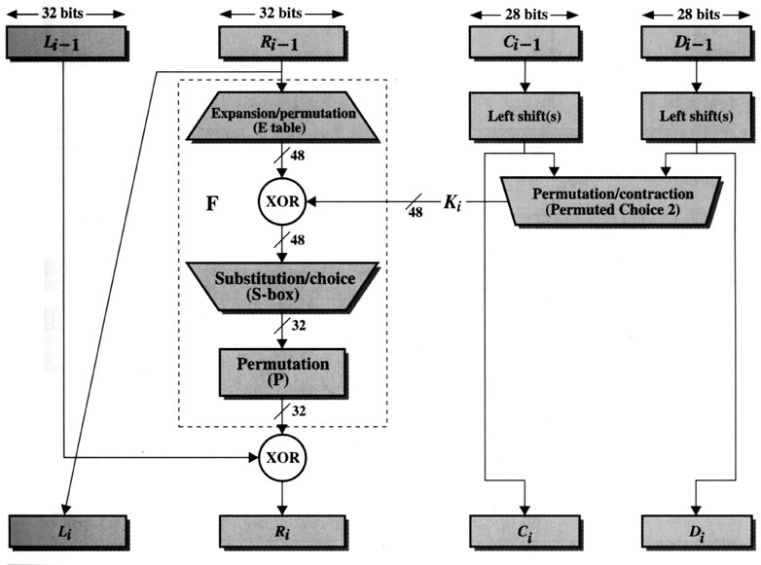
Key Generation->Compression Method
(Encryption)
[1]

Slide 20
Step 2: Expansion/permutation:
Expansion permutation table for RPT
32 | 1 | 2 | 3 | 4 | 5
4 | 5 | 6 | 7 | 8 | 9
8 | 9 | 10 | 11 | 12 | 13
12 | 13 | 14 | 45 | 16 | 17
16 | 17 | 18 | 19 | 20 | 21
20 | 21 | 22 | 23 | 24 | 25
24 | 25 | 26 | 27 | 28 | 29
28 | 29 | 30 | 31 | 32 | 1
Expansion
Expansion

Slide 21

Expansion permutation
Since R_{I−1} is a 32-bit input and K_{I} is a 48-bit key, we first need to expand R_{I−1} to 48 bits.

Slide 22
(XOR)
After the expansion permutation, DES uses the XOR operation on the expanded right section and the round key. Note that both the right section and the key are 48-bits in length. Also note that the round key is used only in this operation.
STEP 1 (XOR) STEP 2 = RESULT FOR NEXT STEP

Slide 23
Encryption (Round)
(Key Generation)
[1]

Slide 24

Step 3: S-Box Substitution

Slide 25
The S-Boxes
Eight S-boxes each map 6 to 4 bits
Each S-box is specified as a 4 x 16 table
  each row is a permutation of 0-15
  outer bits 1 & 6 of input are used to select one of the four rows
  inner 4 bits of input are used to select a column
All the eight boxes are different.
Notes:
The example lists 8 6-bit values (ie 18 in hex is 011000 in binary, 09 hex is 001001 binary, 12 hex is 010010 binary, 3d hex is 111101 binary etc), each of which is replaced following the process detailed above using the appropriate S-box. ie
S1(011000) lookup row 00 col 1100 in S1 to get 5
S2(001001) lookup row 01 col 0100 in S2 to get 15 = f in hex
S3(010010) lookup row 00 col 1001 in S3 to get 13 = d in hex
S4(111101) lookup row 11 col 1110 in S4 to get 2 etc

Slide 26
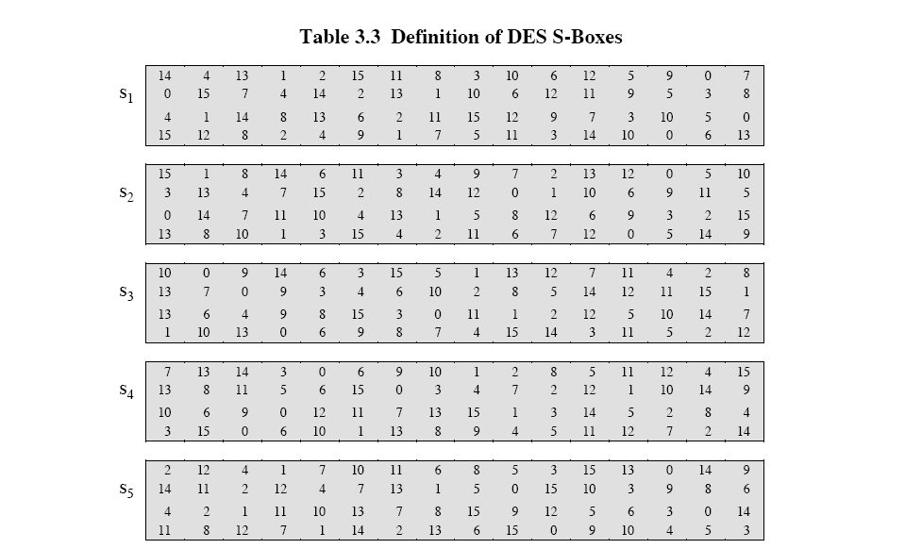
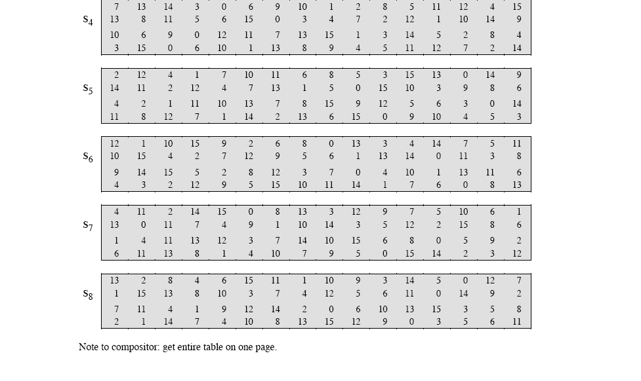
Encryption (Round)
S-box

Slide 27
Box S₁
0 1 2 3 4 5 6 7 8 9 10 11 12 13 14 15
14 | 4 | 13 | 1 | 2 | 15 | 11 | 8 | 3 | 10 | 6 | 12 | 5 | 9 | 0 | 7
0 | 15 | 7 | 4 | 14 | 2 | 13 | 1 | 10 | 6 | 12 | 11 | 6 | 5 | 3 | 8
4 | 1 | 14 | 8 | 13 | 6 | 2 | 11 | 15 | 12 | 9 | 7 | 3 | 10 | 5 | 0
15 | 12 | 8 | 2 | 4 | 9 | 1 | 7 | 5 | 11 | 3 | 14 | 10 | 0 | 6 | 13
0
1
2
3
For example, S₁(101010) = 6 = 0110.

Slide 28
Step 4: P-BOX permutation->Replacement of bit
INPUT POSITION 16 = OUTPUT POSITION 1
P
16 | 7 | 20 | 21 | 29 | 12 | 28 | 17
1 | 15 | 23 | 26 | 5 | 18 | 31 | 10
2 | 8 | 24 | 14 | 32 | 27 | 3 | 9
9 | 13 | 30 | 6 | 22 | 11 | 4 | 25

Slide 29
Step 5:XOR & SWAP
L_{i-1}
R_{i-1}
Expansion/permutation (E_table)
XOR
K_{i}
F
Substitution/choice (S-box)
Permutation (P)
XOR
L_{i}
R_{i}
Next Round

Slide 30
Final Permutation
At the end of the 16 rounds, it is performed only once.
Simple transposition
IP⁻¹
Bit | 0 | 1 | 2 | 3 | 4 | 5 | 6 | 7
1 | 40 | 8 | 48 | 16 | 56 | 24 | 64 | 32
9 | 39 | 7 | 47 | 15 | 55 | 23 | 63 | 31
17 | 38 | 6 | 46 | 14 | 54 | 22 | 62 | 30
25 | 37 | 5 | 45 | 13 | 53 | 21 | 61 | 29
33 | 36 | 4 | 44 | 12 | 52 | 20 | 60 | 28
41 | 35 | 3 | 43 | 11 | 51 | 19 | 59 | 27
49 | 34 | 2 | 42 | 10 | 50 | 18 | 58 | 26
57 | 33 | 1 | 41 | 9 | 49 | 17 | 57 | 25

Slide 31
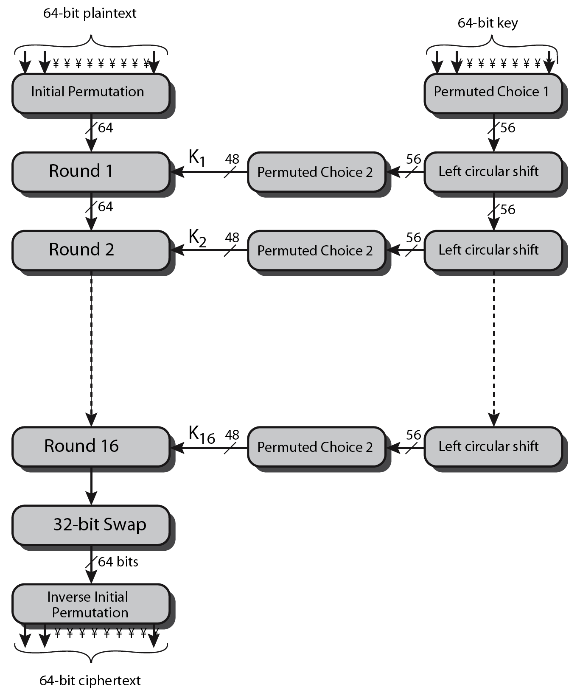
DES Encryption Overview

Slide 32
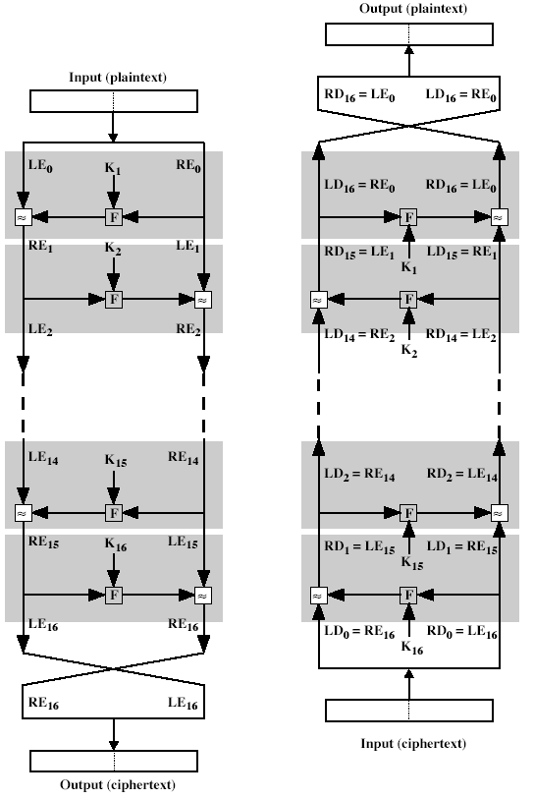
Decryption
The same algorithm as encryption.
Reversed the order of key (Key₁₆, Key₁₅, … Key₁).
For example:
  IP undoes IP⁻¹ step of encryption.
  1st round with SK16 undoes 16th encrypt round.
[1]

Slide 33
Avalanche Effect
Avalanche effect:
  A small change in the plain text or in the key results in a significant change in the cipher text.
DES exhibits a strong avalanche effect
  Changing 1 bit in the plaintext affects 34 bits in the cipher text on average.
  Changing 1 bit in the key affects 35 bits in the cipher text on average.
  See the table in the next page…..

Slide 34
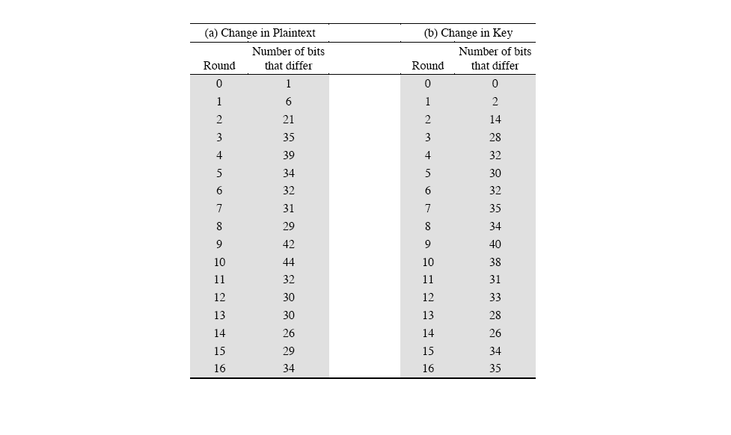
DES Exhibits A Strong Avalanche Effect

Slide 35
Attacks on DES
Brute-force key search
  Only Half of the possible keys space is used.
  Trying 1 key per microsecond would take 1000+ years on average, due to the large key space size, 2⁵⁶ ≈ 7.2×10¹⁶.
Differential cryptanalysis
  Possible to find a key with 2⁴⁷ plain text-cipher text samples
  Known-plaintext attack
Liner cryptanalysis
  Possible to find a key with 2⁴³ plain text-cipher text samples
  Known-plaintext attack

Slide 36
Differential cryptanalysis
In 1990 by Eli Biham & Adi Shamir
It looks at pairs of CT whose PT have differences.
It analyses progress of these differences.
The idea is choose pairs of PT with fixed differences.
The 2 PT can be chosen at random, as long as they satisfy specific difference condition.
Resulting differences in the cipher texts, different likelihood too different keys.
As more & more cipher text pairs are analyzed, the correct key emerges.

Slide 37
Linear Cryptanalysis
Invented by Mitsuru Matsui
It based on linear approximations.
XOR some PT bits together.
XOR some CT bits together.
XOR the result.
We will get a single bit , which is the XOR of some of the key bits.

Slide 38
Timing Attacks
Observe how long it takes for the algorithm to decrypt different blocks of CT.
Try to obtain PT or key used for Encryption.
Time may wary w.r.t sized of CT blocks.
clear a replacement for DES was needed
  theoretical attacks that can break it
  demonstrated exhaustive key search attacks

Slide 39
DES Cracker
DES Cracker:
  A DES key search machine
  contains 1536 chips
  Cost: $250,000.
  could search 88 billion keys per second
  won RSA Laboratory’s “DES Challenge II-2” by successfully finding a DES key in 56 hours.
DES is feeling its age. A more secure cipher is needed.

Slide 40
Ultimately DES was proved insecure
  In 1997 on Internet in a few months
  in 1998 on dedicated h/w in a few days
  In 1999 above combined in 22hrs!
  The major criticism of DES regards its key length. Fortunately DES is not a group. This means that we can use double or triple DES to increase the key size.
  H/W->Processing Speeds, Memory, Parallel Processing. Etc.

Slide 41
Multiple Encryption with DES
In 2001, NIST published the Advanced Encryption Standard (AES) to replace DES.
But users in commerce and finance are not ready to give up on DES.
As a temporary solution to DES’s security problem, one may encrypt a message (with DES) multiple times using multiple keys:
  2DES is not much securer than the regular DES
  So, 3DES with either 2 or 3 keys is used used in PGP.

Slide 42
2DES
Consider 2DES with two keys:
  C = E_{K2}(E_{K1}(P))
Decryption: P = D_{K1}(D_{K2}(C))
Key length: 56 x 2 = 112 bits
This should have thwarted brute-force attacks?
Wrong!

Slide 43
Meet-in-the-Middle Attack on 2DES
2-DES: C = E_{K2}(E_{K1}(P))
Merkle & Hellman
Given a known pair (P, C), attack as follows:
  Encrypt P with all 2⁵⁶ possible keys for K1.
  Decrypt C with all 2⁵⁶ possible keys for K2.
  If E_{K1’}(P) = D_{K2’}(C), try the keys on another (P’, C’).
  If works, (K1’, K2’) = (K1, K2) with high probability.
  Takes O(2⁵⁶) steps; not much more than attacking 1-DES.
E_{K1}
E_{K2}
P C

Slide 44
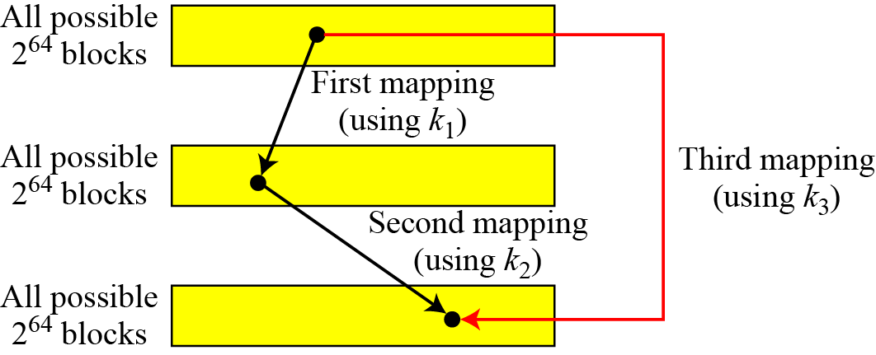
A substitution that maps every possible input to every possible output is a group.
Figure Composition of mapping
6.<number>

Slide 45
Why Triple-DES?
meet-in-the-middle attack
  works whenever use a cipher twice
  since X = E_{K1}[P] = D_{K2}[C]
  attack by encrypting P with all keys and store
  then decrypt C with keys and match X value
  can show takes O(2⁵⁶) steps

Slide 46
Triple-DES with Three-Keys
although are no practical attacks on two-key Triple-DES have some indications
can use Triple-DES with Three-Keys to avoid even these
  C = E_{K3}[E_{K2}[E_{K1}[P]]]
has been adopted by some Internet applications,
E.g PGP, S/MIME
Highly Secure

Slide 47
Triple-DES with Two-Keys
If algorithm uses 3 encryptions
  would seem to need 3 distinct keys
but can we use 2 keys with E-D-E sequence
  C = E_{K1}[D_{K2}[E_{K1}[P]]]
  P = D_{K1}[E_{K2}[D_{K1}[C]]]
  So Triple DES work with two keys
  This is called as EDE mode.
standardized in ANSI X9.17 & ISO8732
no current known practical attacks
Notes:
Triple-DES with two keys is a popular alternative to single-DES, but suffers from being 3 times slower to run.
Although there are no practical attacks, have some indications of attack approaches.
Hence some are now adopting Triple-DES with three keys for greater sucurity.

Slide 48
References
[1] William Stallings, Cryptography and
Network Security, 1999.

